Slide 1
MODULE – 4 NORMALIZATION: DATABASE DESIGN THEORY
INTRODUCTION TO NORMALIZATION USING FUNCTIONAL AND MULTIVALUED DEPENDENCIES
NORMALIZATION ALGORITHMS
Prepared by Mushtaq Ahmed, Assistant Professor, Dept. of ISE

Slide 2
INTRODUCTION TO NORMALIZATION USING FUNCTIONAL AND MULTIVALUED DEPENDENCIES

Slide 3
Informal Design Guidelines for Relational Databases
Functional Dependencies
Normal Forms:
1NF, 2NF, 3NF, BCNF,
Inference Rules
Algorithms for Relational Database Schema Design

Slide 4
Informal Design Guidelines for Relational Databases (1)
What is relational database design?
The grouping of attributes to form "good" relation schemas
Two levels of relation schemas
The logical "user view" level
The storage "base relation" level
Design is concerned mainly with base relations
What are the criteria for "good" base relations?

Slide 5
Informal Design Guidelines for Relational Databases
Making sure that the semantics of the attributes is clear in schema
Reducing the redundant information in tuples
Reducing NULL values in tuples
Disallowing the possibility of generating spurious tuples.

Slide 6
Semantics of the Relation Attributes
GUIDELINE 1: Informally, each tuple in a relation should represent one entity or relationship instance. (Applies to individual relations and their attributes).
Attributes of different entities (EMPLOYEEs, DEPARTMENTs, PROJECTs) should not be mixed in the same relation
Only foreign keys should be used to refer to other entities
Entity and relationship attributes should be kept apart as much as possible.
Bottom Line: Design a schema that can be explained easily relation by relation. The semantics of attributes should be easy to interpret.

Slide 7
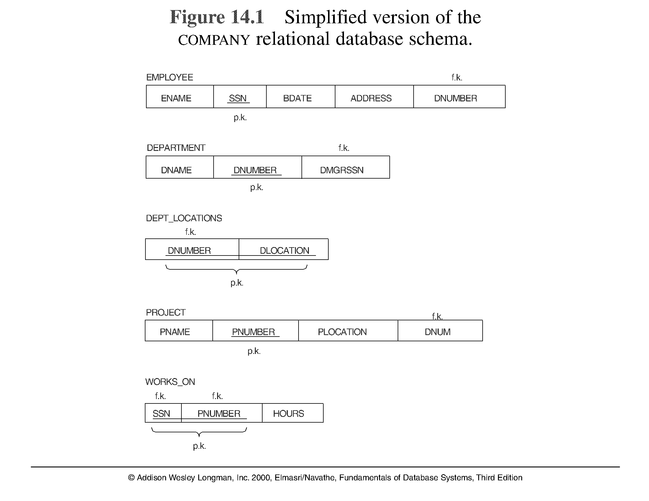
A simplified COMPANY relational database schema

Slide 8
Redundant Information in Tuples and Update Anomalies
Mixing attributes of multiple entities may cause problems
Information is stored redundantly wasting storage
Problems with update anomalies
Insertion anomalies
Deletion anomalies
Modification anomalies

Slide 9
EXAMPLE OF AN UPDATE ANOMALY (1)
Consider the relation:
EMP_PROJ ( Emp#, Proj#, Ename, Pname, No_hours)
Update Anomaly: Changing the name of project number P1 from “Billing” to “Customer-Accounting” may cause this update to be made for all 100 employees working on project P1.

Slide 10
EXAMPLE OF AN UPDATE ANOMALY (2)
Insert Anomaly: Cannot insert a project unless an employee is assigned to .
Inversely - Cannot insert an employee unless an he/she is assigned to a project.
Delete Anomaly: When a project is deleted, it will result in deleting all the employees who work on that project. Alternately, if an employee is the sole employee on a project, deleting that employee would result in deleting the corresponding project.

Slide 11
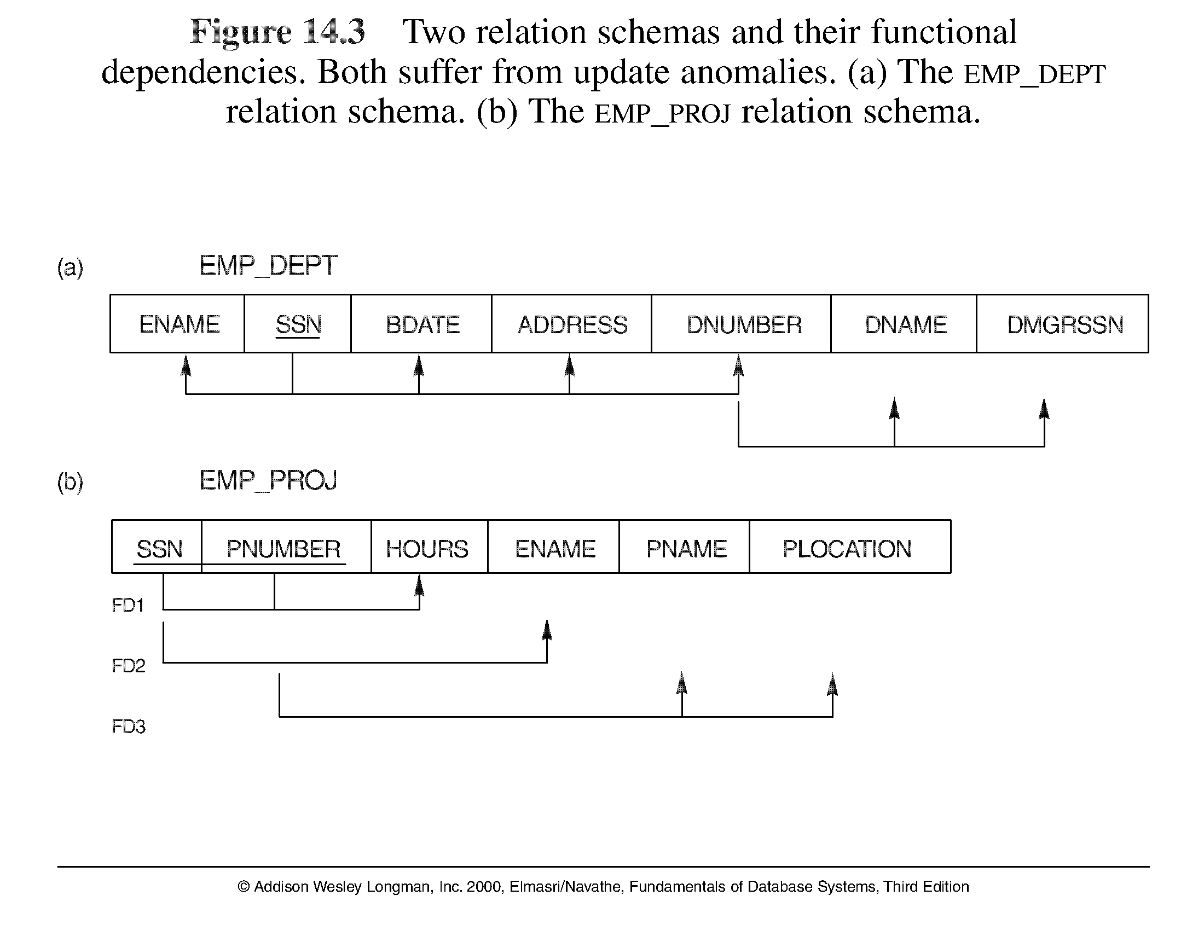
Two relation schemas suffering from update anomalies

Slide 12
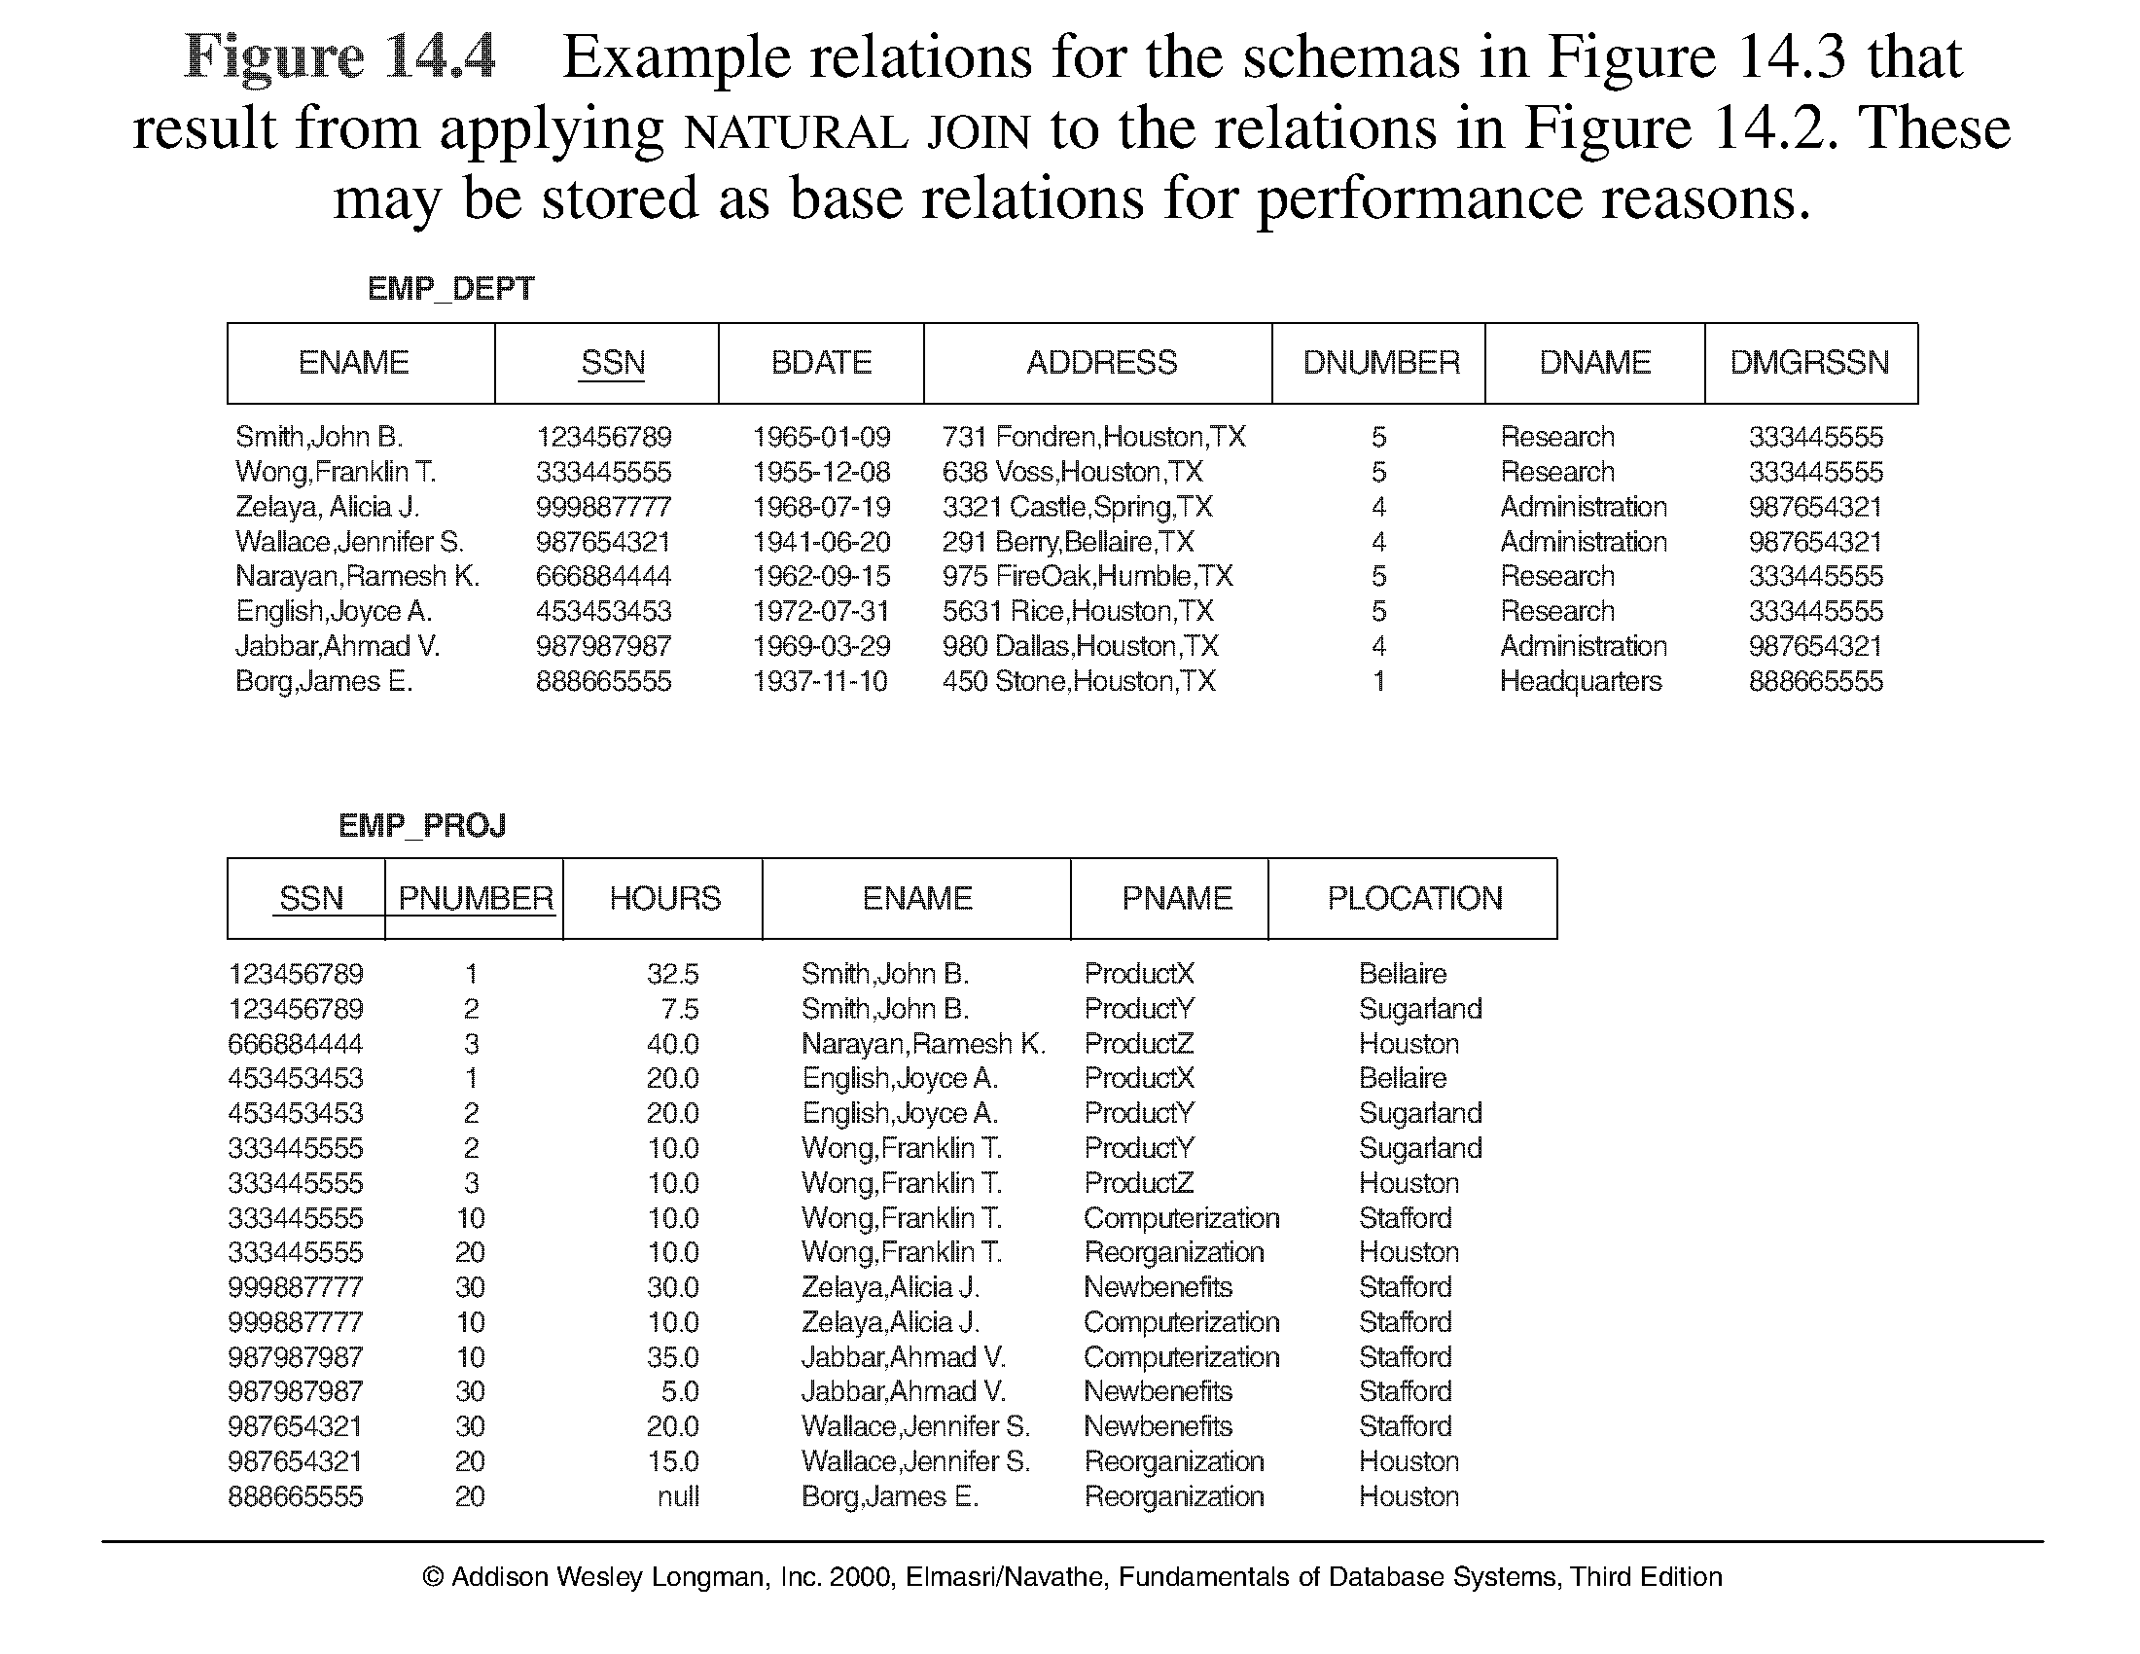
Example States for EMP_DEPT and EMP_PROJ

Slide 13
Guideline to Redundant Information in Tuples and Update Anomalies
GUIDELINE 2: Design a schema that does not suffer from the insertion, deletion and update anomalies. If there are any present, then note them so that applications can be made to take them into account

Slide 14
Null Values in Tuples
GUIDELINE 3: Relations should be designed such that their tuples will have as few NULL values as possible
Attributes that are NULL frequently could be placed in separate relations (with the primary key)
Reasons for nulls:
attribute not applicable or invalid
attribute value unknown (may exist)
value known to exist, but unavailable

Slide 15
Spurious Tuples
Bad designs for a relational database may result in erroneous results for certain JOIN operations
The "lossless join" property is used to guarantee meaningful results for join operations
GUIDELINE 4: The relations should be designed to satisfy the lossless join condition. No spurious tuples should be generated by doing a natural-join of any relations.

Slide 16
Spurious Tuples (2)
There are two important properties of decompositions:
non-additive or losslessness of the corresponding join
preservation of the functional dependencies.
Note that property (a) is extremely important and cannot be sacrificed. Property (b) is less stringent and may be sacrificed.

Slide 17
Functional Dependencies (1)
Functional dependencies (FDs) are used to specify formal measures of the "goodness" of relational designs
FDs and keys are used to define normal forms for relations
FDs are constraints that are derived from the meaning and interrelationships of the data attributes
A set of attributes X functionally determines a set of attributes Y if the value of X determines a unique value for Y

Slide 18
Functional Dependencies (2)
X -> Y holds if whenever two tuples have the same value for X, they must have the same value for Y
For any two tuples t1 and t2 in any relation instance r(R): If t1[X]=t2[X], then t1[Y]=t2[Y]
X -> Y in R specifies a constraint on all relation instances r(R)
Written as X -> Y; can be displayed graphically on a relation schema as in Figures. ( denoted by the arrow: ).
FDs are derived from the real-world constraints on the attributes

Slide 19
Examples of FD constraints (1)
social security number determines employee name
SSN -> ENAME
project number determines project name and location
PNUMBER -> {PNAME, PLOCATION}
employee ssn and project number determines the hours per week that the employee works on the project
{SSN, PNUMBER} -> HOURS

Slide 20
Examples of FD constraints (2)
An FD is a property of the attributes in the schema R
The constraint must hold on every relation instance r(R)
If K is a key of R, then K functionally determines all attributes in R (since we never have two distinct tuples with t1[K]=t2[K])

Slide 21
Normal Forms Based on Primary Keys
Normalization of Relations
Practical Use of Normal Forms
Definitions of Keys and Attributes Participating in Keys
First Normal Form
Second Normal Form
Third Normal Form

Slide 22
Normalization of Relations (1)
Normalization: The process of decomposing unsatisfactory "bad" relations by breaking up their attributes into smaller relations
Normal form: Condition using keys and FDs of a relation to certify whether a relation schema is in a particular normal form

Slide 23
Normalization of Relations (2)
2NF, 3NF, BCNF based on keys and FDs of a relation schema
4NF based on keys, multi-valued dependencies : MVDs; 5NF based on keys, join dependencies : JDs
Additional properties may be needed to ensure a good relational design (lossless join, dependency preservation)

Slide 24
Practical Use of Normal Forms
Normalization is carried out in practice so that the resulting designs are of high quality and meet the desirable properties
The practical utility of these normal forms becomes questionable when the constraints on which they are based are hard to understand or to detect
The database designers need not normalize to the highest possible normal form. (usually up to 3NF, BCNF or 4NF)
Denormalization: the process of storing the join of higher normal form relations as a base relation—which is in a lower normal form

Slide 25
Definitions of Keys and Attributes Participating in Keys (1)
A superkey of a relation schema R = {A₁, A₂, ...., A_{n}} is a set of attributes S subset-of R with the property that no two tuples t₁ and t₂ in any legal relation state r of R will have t₁[S] = t₂[S]
A key K is a superkey with the additional property that removal of any attribute from K will cause K not to be a superkey any more.

Slide 26
Definitions of Keys and Attributes Participating in Keys (2)
If a relation schema has more than one key, each is called a candidate key. One of the candidate keys is arbitrarily designated to be the primary key, and the others are called secondary keys.
A Prime attribute must be a member of some candidate key
A Nonprime attribute is not a prime attribute—that is, it is not a member of any candidate key.

Slide 27
First Normal Form
Disallows composite attributes, multivalued attributes, and nested relations; attributes whose values for an individual tuple are non-atomic
Considered to be part of the definition of relation
1NF Definition:
It states that the domain of an attribute must include only atomic (simple) values and that the value of any attribute in a tuple must be a single value from the domain of that attribute

Slide 28
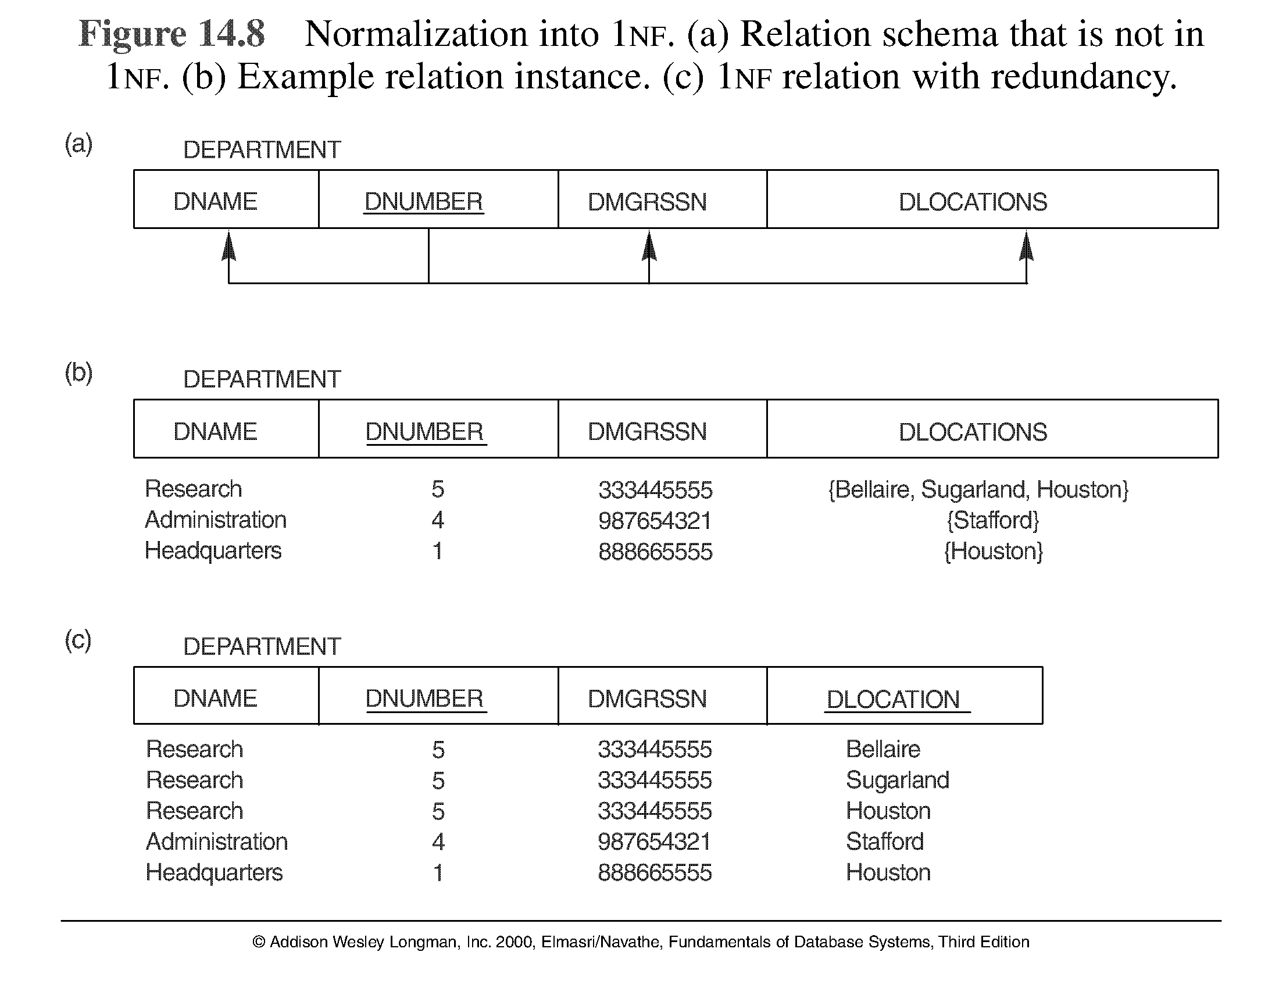
Normalization into 1NF

Slide 29

Normalization nested relations into 1NF

Slide 30
Second Normal Form (1)
Uses the concepts of FDs, primary key
Definitions:
Prime attribute - attribute that is member of the primary key K
Full functional dependency - a FD Y -> Z where removal of any attribute from Y means the FD does not hold any more
Examples: - {SSN, PNUMBER} -> HOURS is a full FD since neither SSN -> HOURS nor PNUMBER -> HOURS hold
- {SSN, PNUMBER} -> ENAME is not a full FD (it is called a partial dependency ) since SSN -> ENAME also holds

Slide 31
Second Normal Form (2)
2NF Definition
A relation schema R is in second normal form (2NF) if every non-prime attribute A in R is fully functionally dependent on the primary key of R
R can be decomposed into 2NF relations via the process of 2NF normalization

Slide 32
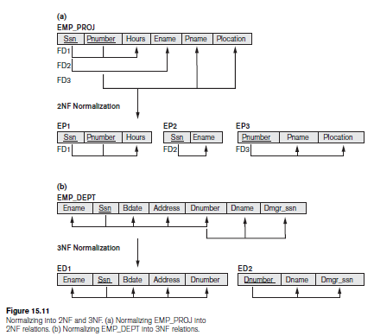
Normalizing into 2NF and 3NF
Note: The above figure is now called Figure 10.10 in Edition 4

Slide 33
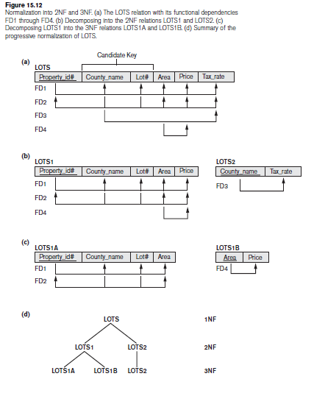
Normalization into 2NF and 3NF

Slide 34
Third Normal Form (1)
Definition:
Transitive functional dependency - a FD X -> Z that can be derived from two FDs X -> Y and Y -> Z
Examples:
- SSN -> DMGRSSN is a transitive FD since
SSN -> DNUMBER and DNUMBER -> DMGRSSN hold
- SSN -> ENAME is non-transitive since there is no set of attributes X where SSN -> X and X -> ENAME

Slide 35
Third Normal Form (2)
3NF Definition
A relation schema R is in third normal form (3NF) if it satisfies 2NF and no non-prime attribute of R is transitively dependent on the primary key
R can be decomposed into 3NF relations via the process of 3NF normalization
NOTE:
In X -> Y and Y -> Z, with X as the primary key, we consider this a problem only if Y is not a candidate key. When Y is a candidate key, there is no problem with the transitive dependency .
E.g., Consider EMP (SSN, Emp#, Salary ).
Here, SSN -> Emp -> Salary and Emp# is a candidate key.

Slide 36
General Normal Form Definitions (For Multiple Keys) (1)
The above definitions consider the primary key only
The following more general definitions take into account relations with multiple candidate keys
A relation schema R is in second normal form (2NF) if every non-prime attribute A in R is fully functionally dependent on every key of R

Slide 37
General Normal Form Definitions (2)
Definition:
Superkey of relation schema R - a set of attributes S of R that contains a key of R
A relation schema R is in third normal form (3NF) if whenever a FD X -> A holds in R, then either:
(a) X is a superkey of R, or
(b) A is a prime attribute of R
NOTE: Boyce-Codd normal form disallows condition (b) above

Slide 38
BCNF (Boyce-Codd Normal Form)
A relation schema R is in Boyce-Codd Normal Form (BCNF) if whenever an FD X -> A holds in R, then X is a superkey of R
Each normal form is strictly stronger than the previous one
Every 2NF relation is in 1NF
Every 3NF relation is in 2NF
Every BCNF relation is in 3NF
There exist relations that are in 3NF but not in BCNF
The goal is to have each relation in BCNF (or 3NF)

Slide 39
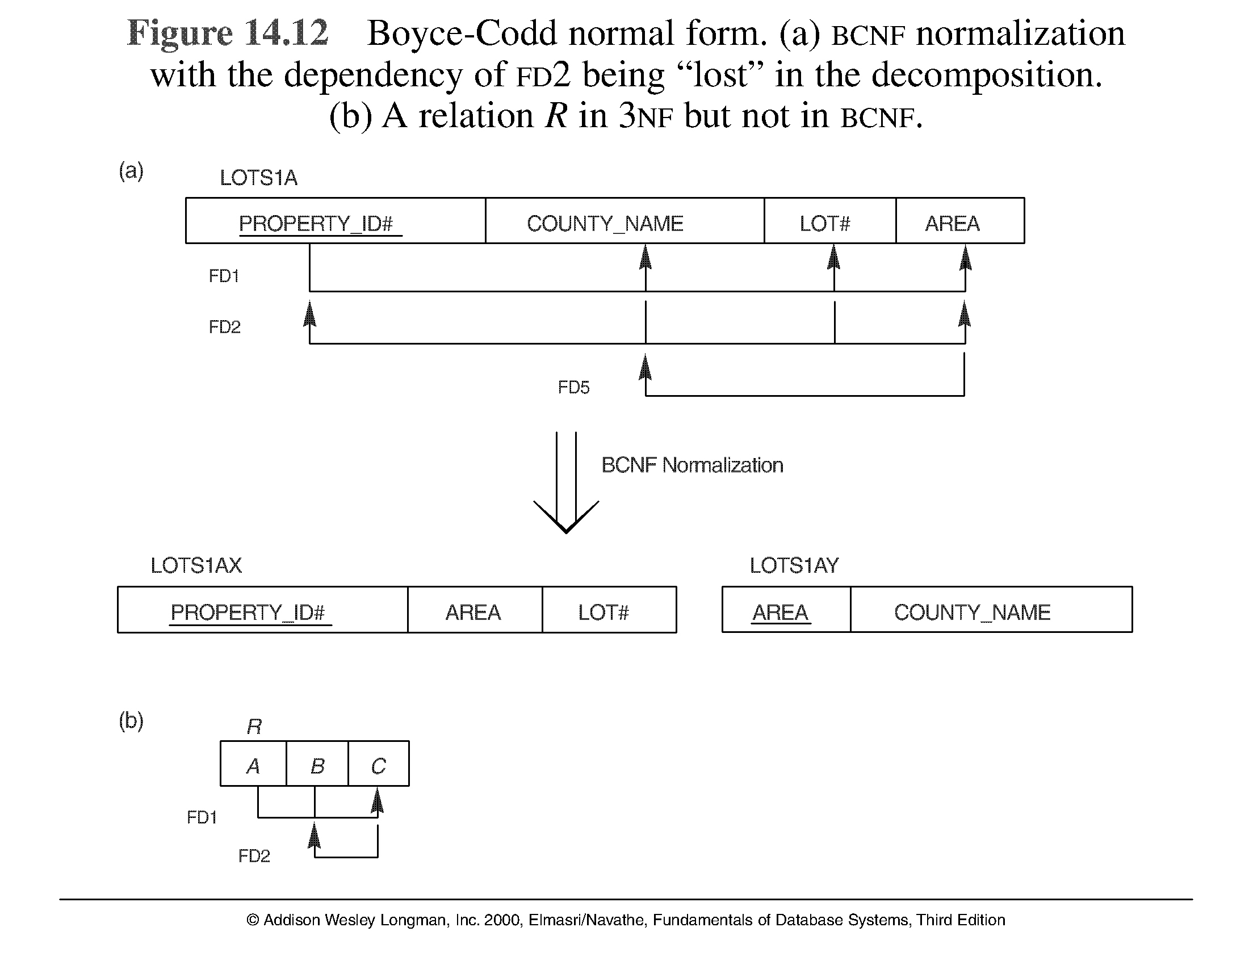
Boyce-Codd normal form

Slide 40
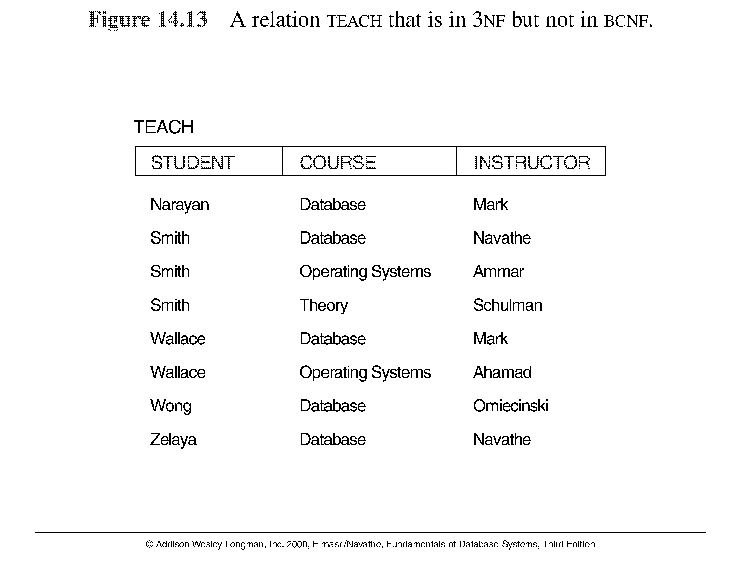
A relation TEACH that is in 3NF but not in BCNF

Slide 41
Achieving the BCNF by Decomposition (1)
Two FDs exist in the relation TEACH:
fd1: { student, course} -> instructor
fd2: instructor -> course
{student, course} is a candidate key for this relation and that the dependencies shown follow the pattern in Figure 10.12 (b). So this relation is in 3NF but not in BCNF
A relation NOT in BCNF should be decomposed so as to meet this property, while possibly forgoing the preservation of all functional dependencies in the decomposed relations. (See Algorithm 11.3)

Slide 42
Achieving the BCNF by Decomposition (2)
Three possible decompositions for relation TEACH
{student, instructor} and {student, course}
{course, instructor } and {course, student}
{instructor, course } and {instructor, student}
All three decompositions will lose fd1. We have to settle for sacrificing the functional dependency preservation. But we cannot sacrifice the non-additivity property after decomposition.
Out of the above three, only the 3rd decomposition will not generate spurious tuples after join.(and hence has the non-additivity property).
A test to determine whether a binary decomposition (decomposition into two relations) is nonadditive (lossless) is discussed in section 11.1.4 under Property LJ1. Verify that the third decomposition above meets the property.

Slide 43
NORMALIZATION ALGORITHMS

Slide 44
Closure of f
The set of all dependencies that include F as well as all dependencies that can be inferred from F is called the closure of F; it is denoted by F+.
Example…
F = {Ssn → {Ename, Bdate, Address, Dnumber}, Dnumber → {Dname, Dmgr_ssn} }
Some of the additional functional dependencies that we can infer from F are the following:
Ssn → {Dname, Dmgr_ssn}
Ssn → Ssn
Dnumber → Dname

Slide 45
2.2 Inference Rules for FDs (1)
Given a set of FDs F, we can infer additional FDs that hold whenever the FDs in F hold
Armstrong's inference rules:
IR1. (Reflexive) If Y subset-of X, then X -> Y
IR2. (Augmentation) If X -> Y, then XZ -> YZ
(Notation: XZ stands for X U Z)
IR3. (Transitive) If X -> Y and Y -> Z, then X -> Z
IR1, IR2, IR3 form a sound and complete set of inference rules

Slide 46
Inference Rules for FDs (2)
Some additional inference rules that are useful:
(Decomposition) If X -> YZ, then X -> Y and X -> Z
(Union) If X -> Y and X -> Z, then X -> YZ
(Psuedotransitivity) If X -> Y and WY -> Z, then WX -> Z
The last three inference rules, as well as any other inference rules, can be deduced from IR1, IR2, and IR3 (completeness property)

Slide 47
PROOF
Proof of IR1.
Suppose that X ⊇ Y and that two tuples t1 and t2 exist in some relation instance r of R such that t1 [X] = t2 [X]. Then t1[Y] = t2[Y] because X ⊇ Y; hence, X→Y must hold in r.
Proof of IR2 (by contradiction).
Assume that X→Y holds in a relation instance r of R but that XZ→YZ does not hold. Then there must exist two tuples t1 and t2 in r such that (1) t1 [X] = t2 [X], (2) t1 [Y] = t2 [Y], (3) t1 [XZ] = t2 [XZ], and (4) t1 [YZ] ≠ t2 [YZ]. This is not possible because from (1) and (3) we deduce (5) t1 [Z] = t2 [Z], and from (2) and (5) we deduce (6) t1 [YZ] = t2 [YZ], contradicting (4).
Proof of IR3.
Assume that (1) X → Y and (2) Y → Z both hold in a relation r. Then for any two tuples t1 and t2 in r such that t1 [X] = t2 [X], we must have (3) t1 [Y] = t2 [Y], from assumption (1); hence we must also have (4) t1 [Z] = t2 [Z] from (3) and assumption (2); thus X→Z must hold in r.

Slide 48
CONTD
Proof of IR4 (Using IR1 through IR3).
X→YZ (given).
YZ→Y (using IR1 and knowing that YZ ⊇ Y).
X→Y (using IR3 on 1 and 2).
Proof of IR5 (using IR1 through IR3).
X→Y (given).
X→Z (given).
X→XY (using IR2 on 1 by augmenting with X; notice that XX = X).
XY→YZ (using IR2 on 2 by augmenting with Y).
X→YZ (using IR3 on 3 and 4).
Proof of IR6 (using IR1 through IR3).
X→Y (given).
WY→Z (given).
WX→WY (using IR2 on 1 by augmenting with W).
WX→Z (using IR3 on 3 and 2).

Slide 49
The inference rules IR1 through IR3 are sound and complete
sound because given a set of functional dependencies F specified on a relation schema R, any dependency that we can infer from F by using IR1 through IR3 holds in every relation state r or R that satisfies the dependencies in F.
complete because using IR1 through IR3 repeatedly to infer dependencies until no more dependencies can be inferred results in the complete set of all possible dependencies that can be inferred from F.

Slide 50
CODD’s Rule
Information Rule
Guaranteed Access Rule
Systematic Treatment of NULL Values
Active Online Catalog
Comprehensive Data Sub-Language Rule
View Updating Rule
High-Level Insert, Update, and Delete Rule
Physical Data Independence
Logical Data Independence
Integrity Independence
Distribution Independence
Non-Subversion Rule

Slide 51
Closure of x under f
For each set of attributes X, we determine the set X⁺ of attributes that are functionally determined by X based on F; X⁺ is called the closure of X under F.

Slide 52
Algorithm: Determining X+, the Closure of X under F
Input: A set F of FDs on a relation schema R, and a set of attributes X, which is a subset of R.
X⁺ := X;
repeat
oldX ⁺ := X ⁺;
for each functional dependency Y→Z in F do
if X ⁺ ⊇ Y then X ⁺ := X ⁺ ∪ Z;
until (X ⁺ = oldX ⁺);

Slide 53
Equivalence of sets of functional dependencies
A set of functional dependencies F is said to cover another set of functional dependencies E if every FD in E is also in F+; that is, if every dependency in E can be inferred from F; alternatively, we can say that E is covered by F.
Two sets of functional dependencies E and F are equivalent if E+ = F+. Therefore, equivalence means that every FD in E can be inferred from F, and every FD in F can be inferred from E; that is, E is equivalent to F if both the conditions—E covers F and F covers E—hold.

Slide 54
Minimal Sets of FDs
A set of functional dependencies F to be minimal if it satisfies the following conditions:
Every dependency in F has a single attribute for its right-hand side.
We cannot replace any dependency X → A in F with a dependency Y → A, where Y is a proper subset of X, and still have a set of dependencies that is equivalent to F.
We cannot remove any dependency from F and still have a set of dependencies that is equivalent to F.

Slide 55
Minimal cover
A minimal cover of a set of functional dependencies E is a minimal set of dependencies (in the standard canonical form and without redundancy) that is equivalent to E

Slide 56
Algorithm: Finding a Minimal Cover F for a Set of Functional Dependencies E
Input: A set of functional dependencies E.
Set F := E.
Replace each functional dependency X→{A1, A2, ..., An} in F by the n functional dependencies X→A1, X→A2, ..., X→An.
For each functional dependency X→A in F for each attribute B that is an element of X if { {F – {X→A} } ∪ { (X – {B} ) →A} } is equivalent to F then replace X→A with (X – {B} ) →A in F.
For each remaining functional dependency X→A in F if {F – {X→A} } is equivalent to F, then remove X→A from F.

Slide 57
Example
Find the minimal cover for the following set of functional dependencies:
E : {B→A, D→A, AB→D}.

Slide 58
SOLUTION
All above dependencies are in canonical form (that is, they have only one attribute on the right-hand side), so we have completed step 1 of Algorithm and can proceed to step 2. In step 2 we need to determine if AB→D has any redundant attribute on the left-hand side; that is, can it be replaced by B→D or A→D?
Since B →A, by augmenting with B on both sides (IR2), we have BB → AB, or B→AB (i). However, AB→D as given (ii).
Hence by the transitive rule (IR3), we get from (i) and (ii), B → D. Thus AB→D may be replaced by B→D.
We now have a set equivalent to original E, say E: {B→A, D→A, B→D}. No further reduction is possible in step 2 since all FDs have a single attribute on the left-hand side.
In step 3 we look for a redundant FD in E. By using the transitive rule on B → D and D → A, we derive B → A. Hence B → A is redundant in E and can be eliminated.
Therefore, the minimal cover of E is {B→D, D→A}.

Slide 59
Algorithms for Relational Database Schema Design (7)
Discussion of Normalization Algorithms:
Problems:
The database designer must first specify all the relevant functional dependencies among the database attributes.
These algorithms are not deterministic in general.
It is not always possible to find a decomposition into relation schemas that preserves dependencies and allows each relation schema in the decomposition to be in BCNF (instead of 3NF as in Algorithm 11.4).

Slide 60
Questions
Explain the informal design guidelines for the database design.
Which normal form is based on full functional dependency? Explain the normal form which is based on this.
What is transitive dependency? Explain 3NF with example.
What is multivalued dependency? Explain 4NF with example.
Write an algorithm to find the minimal cover.

